Slide 1



F2 Examen Décembre 2019
Li Kevin
10 min

Slide 2
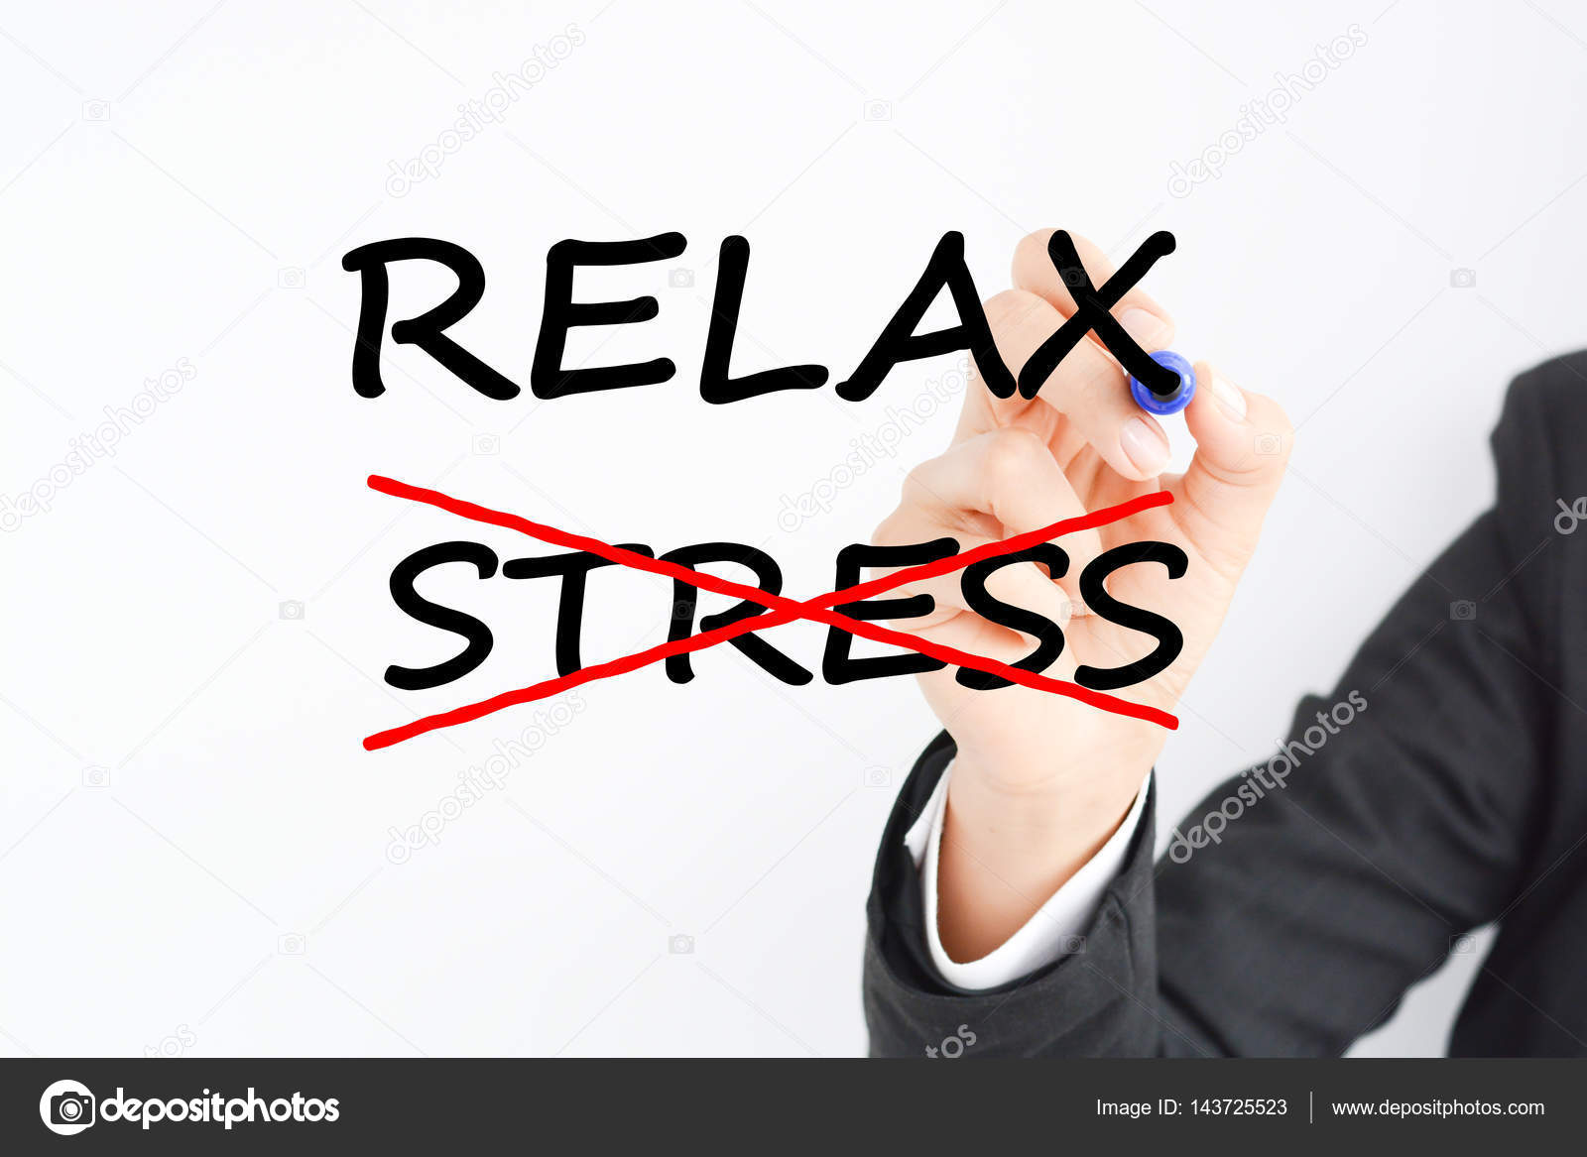
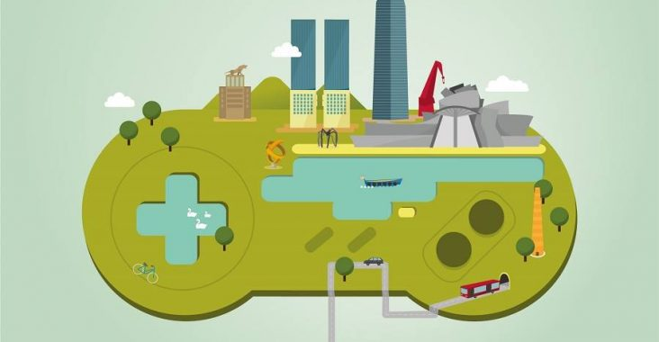

Slide 3
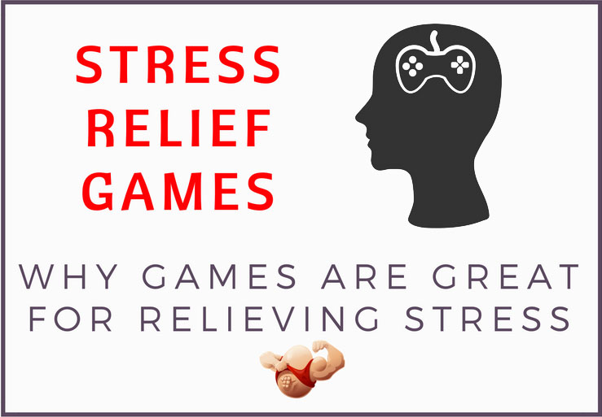
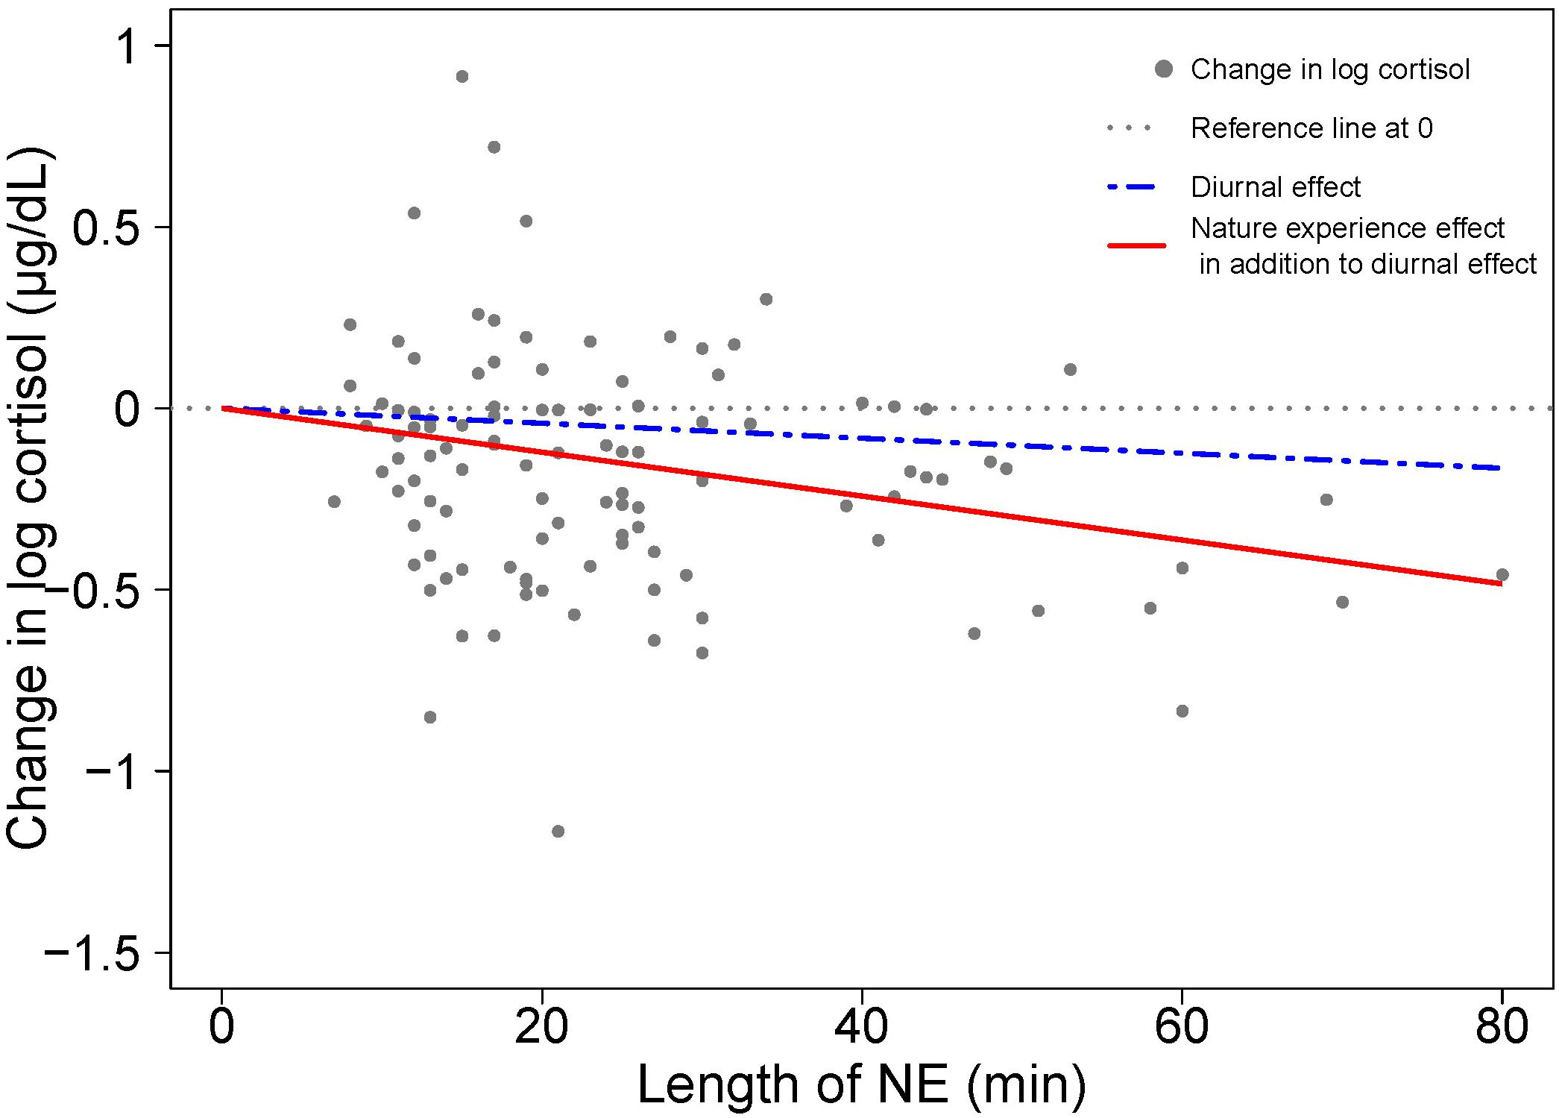

Slide 4
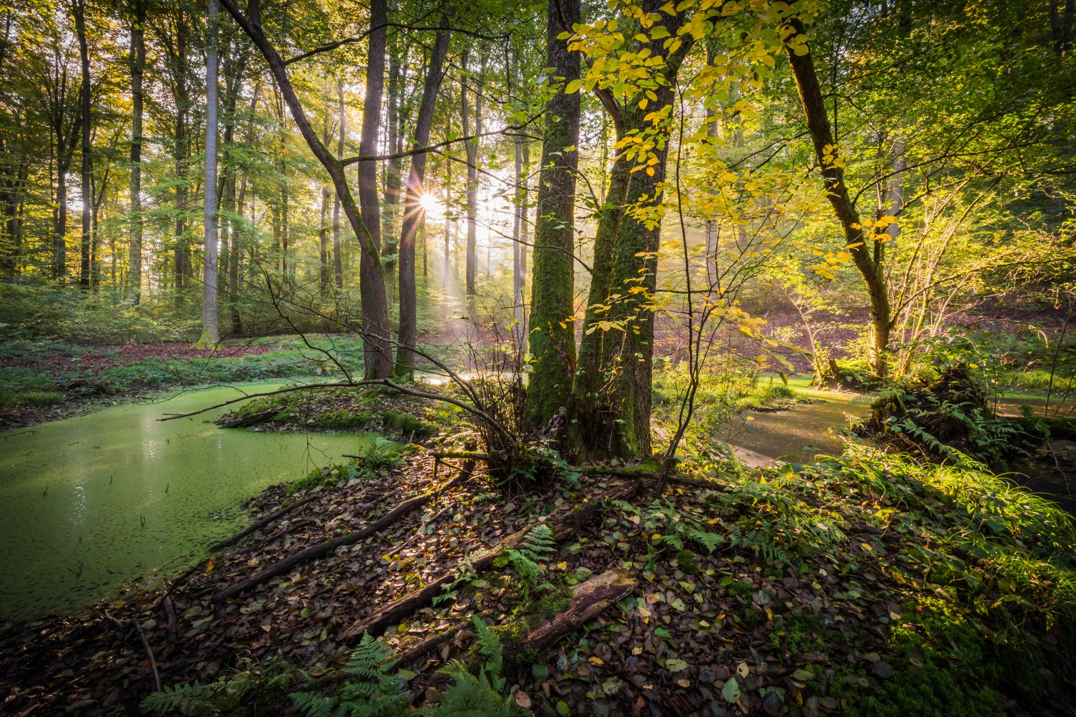
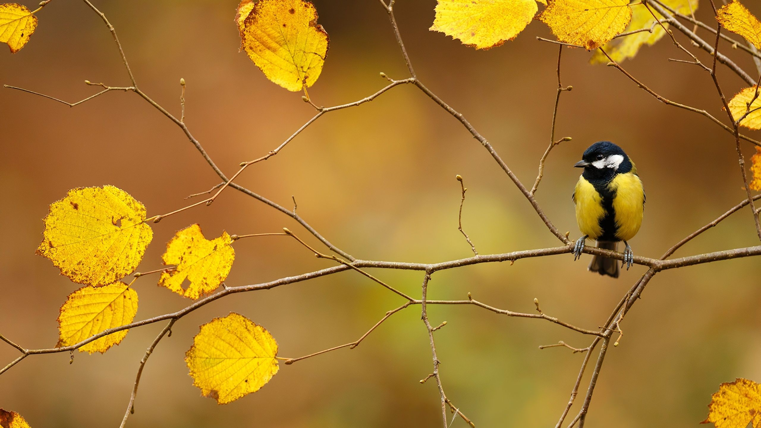
Serenity
Coupez vous du monde extérieur, et appréciez un magnifique paysage relaxant !

Slide 5
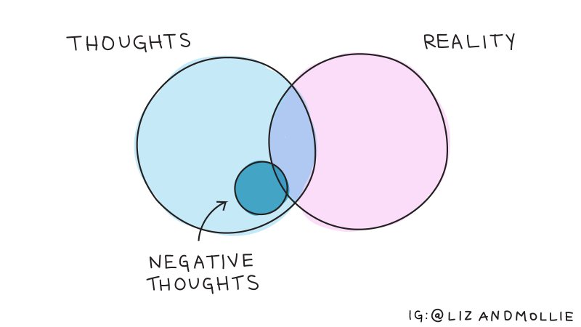
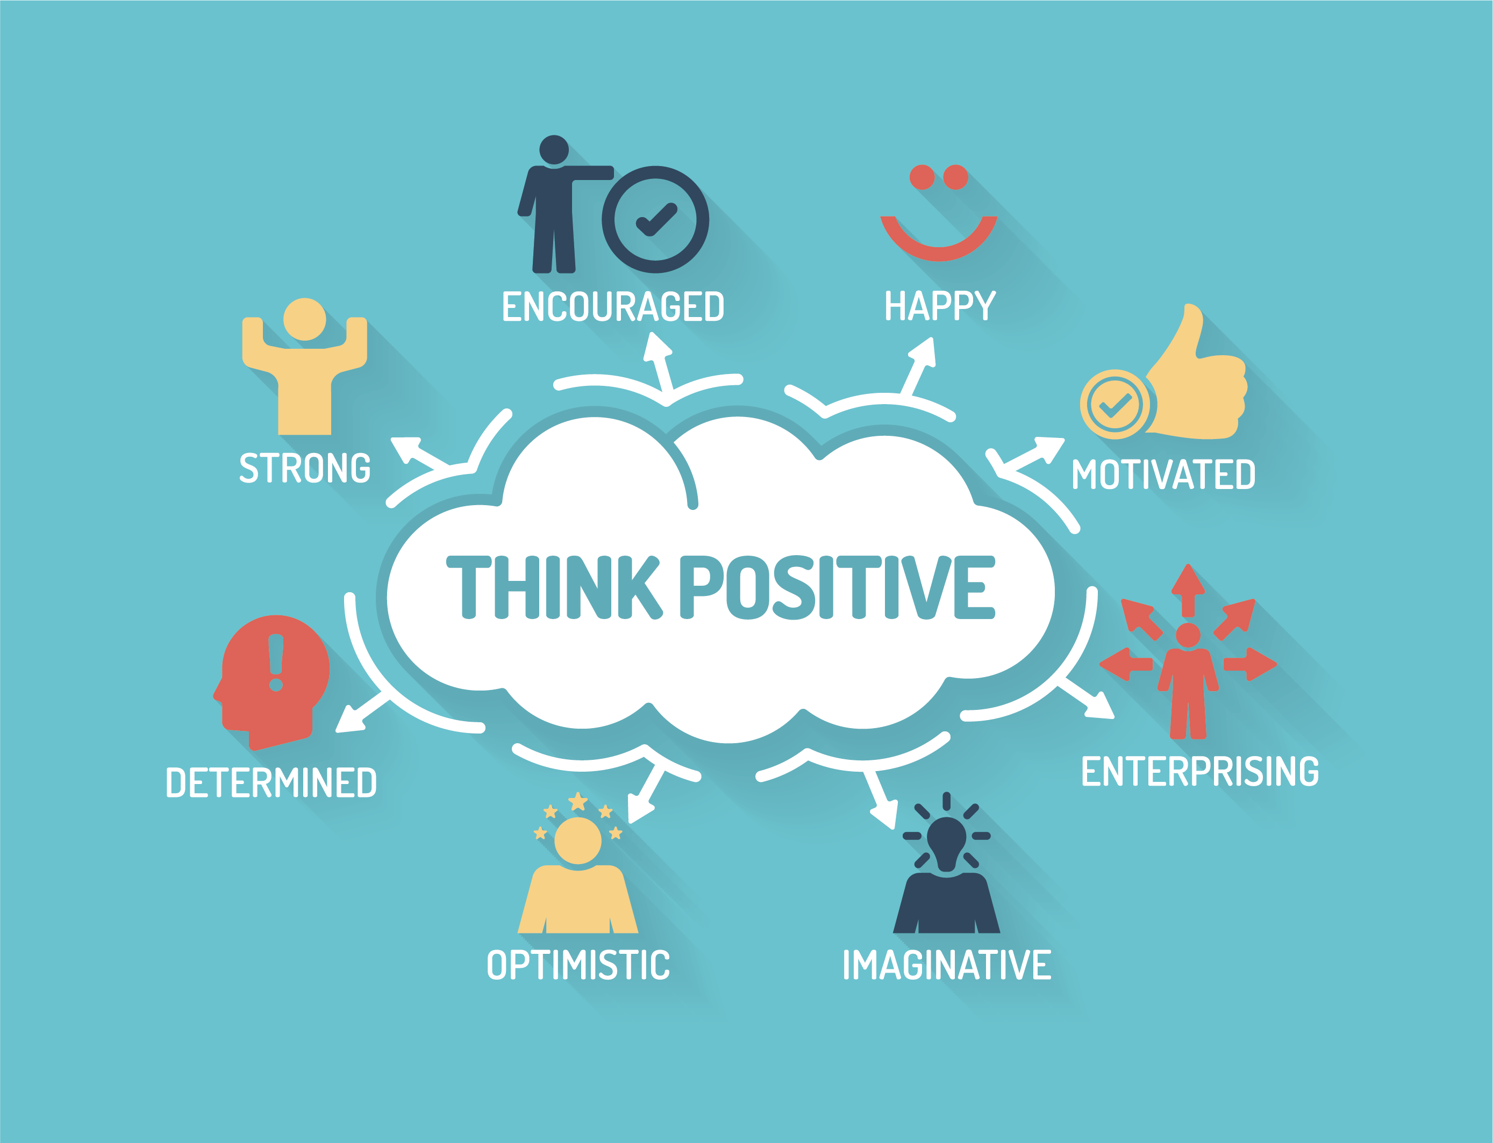

Slide 6

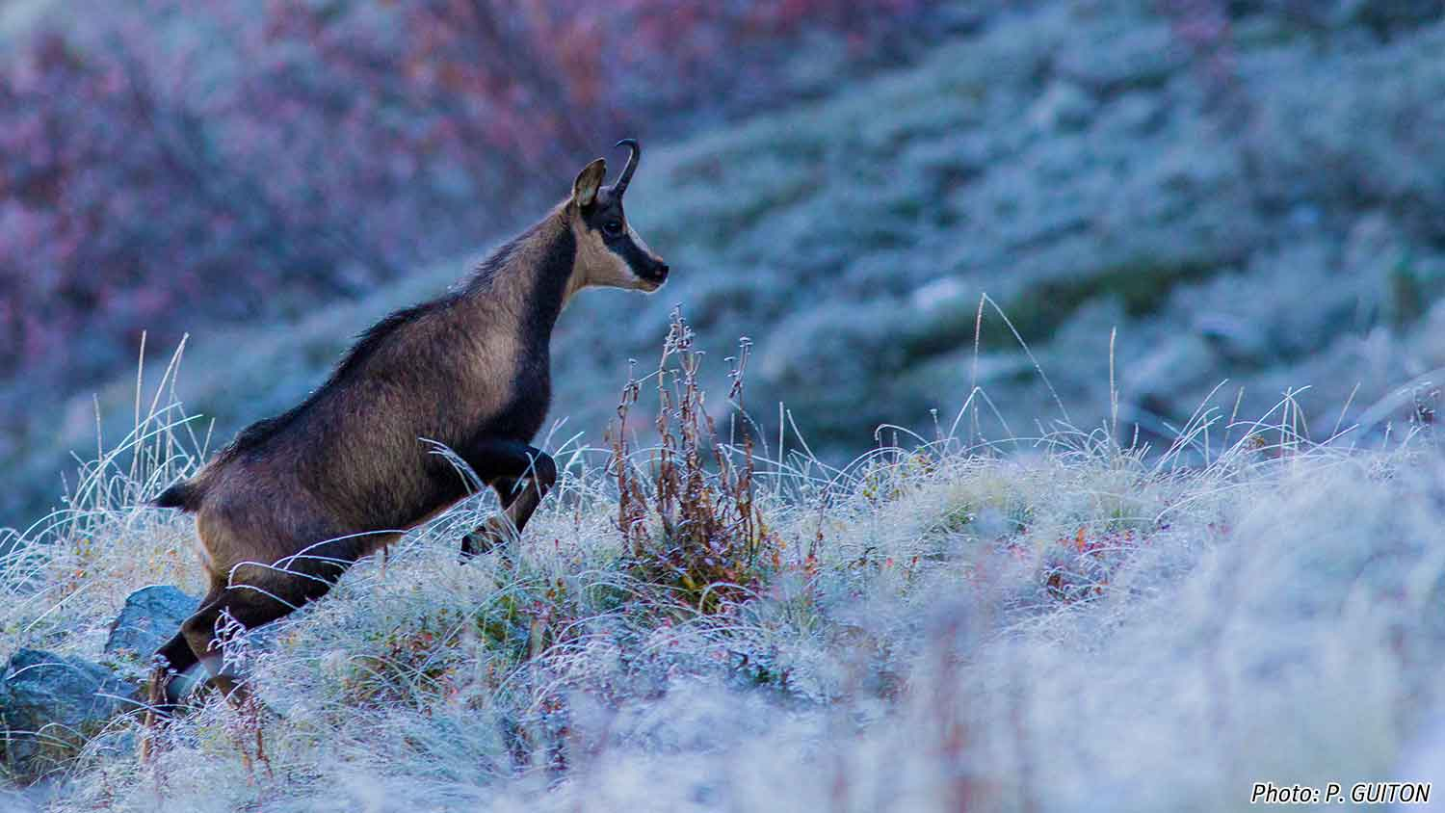

Le futur de Serenity

Slide 7

Sources
https://www.hardboiledbody.com/stress-relief-games/
https://www.frontiersin.org/articles/10.3389/fpsyg.2019.00722/full
http://thepositivelifeco.com/what-is-positive-thinking/
https://www.vice.com/en_us/article/3k7vz3/relieve-anxiety-stop-thinking-negative
Assets :
https://assetstore.unity.com/packages/3d/vegetation/plants/lowpoly-flowers-47083
https://assetstore.unity.com/packages/3d/vegetation/pbr-mushroom-pack-lite-56263
https://assetstore.unity.com/packages/3d/props/interior/books-3356
https://assetstore.unity.com/packages/3d/environments/urban/furnished-cabin-71426
https://assetstore.unity.com/packages/3d/characters/animals/living-birds-15649
https://assetstore.unity.com/packages/3d/characters/animals/butterfly-with-animations-20985
https://assetstore.unity.com/packages/essentials/asset-packs/standard-assets-for-unity-2017-3-32351
https://assetstore.unity.com/packages/3d/environments/nature-starter-kit-2-52977

